Slide 1
Refraction and
Screen Space Reflection
Matthias Feichtinger, David Kranebitter, Dominik Schäfer

Slide 2
Refraction = breaking light

Slide 3
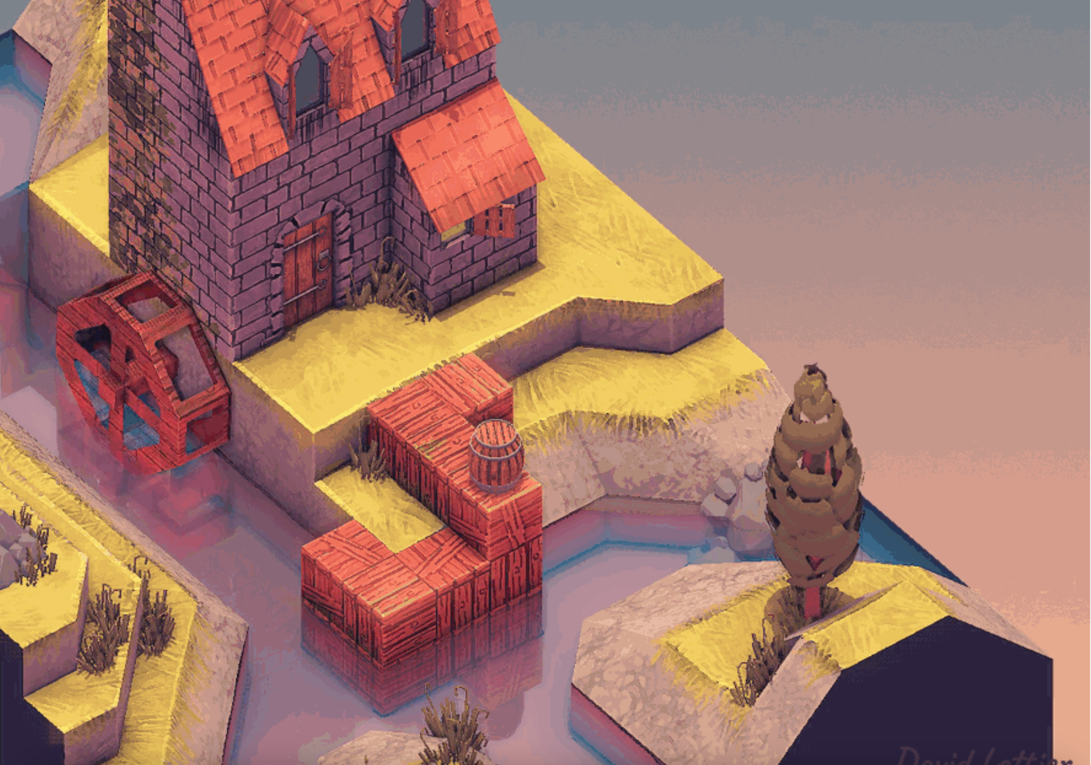
Example of Screen Space Reflection on water

Slide 4
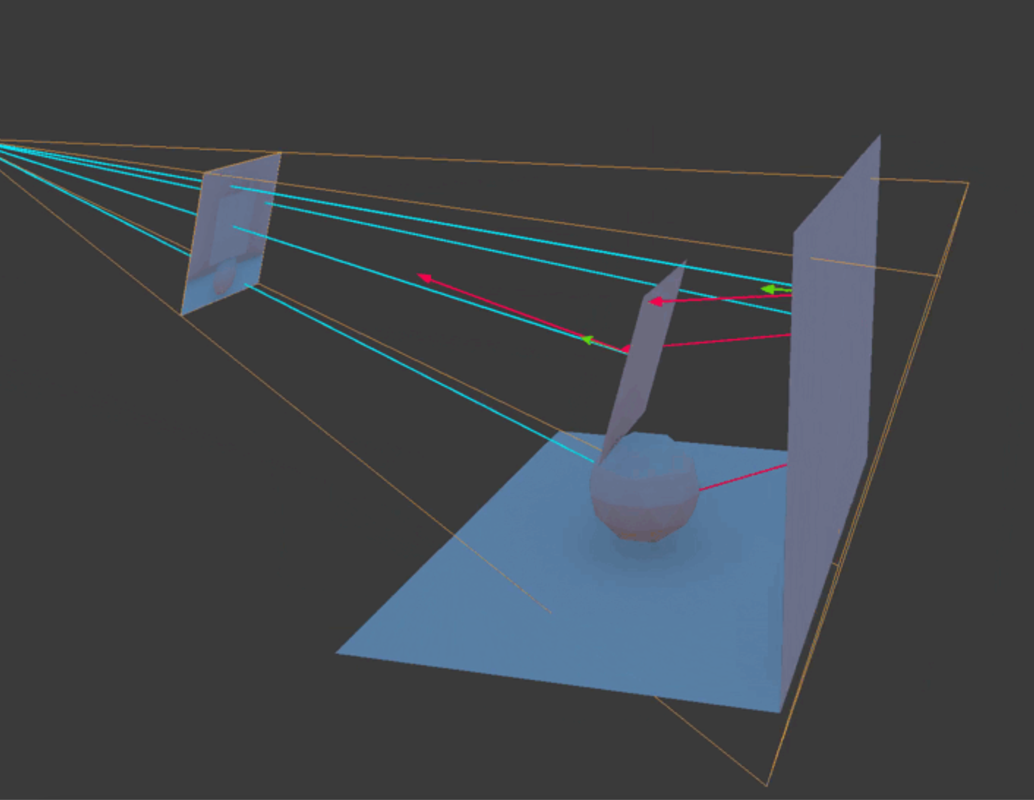
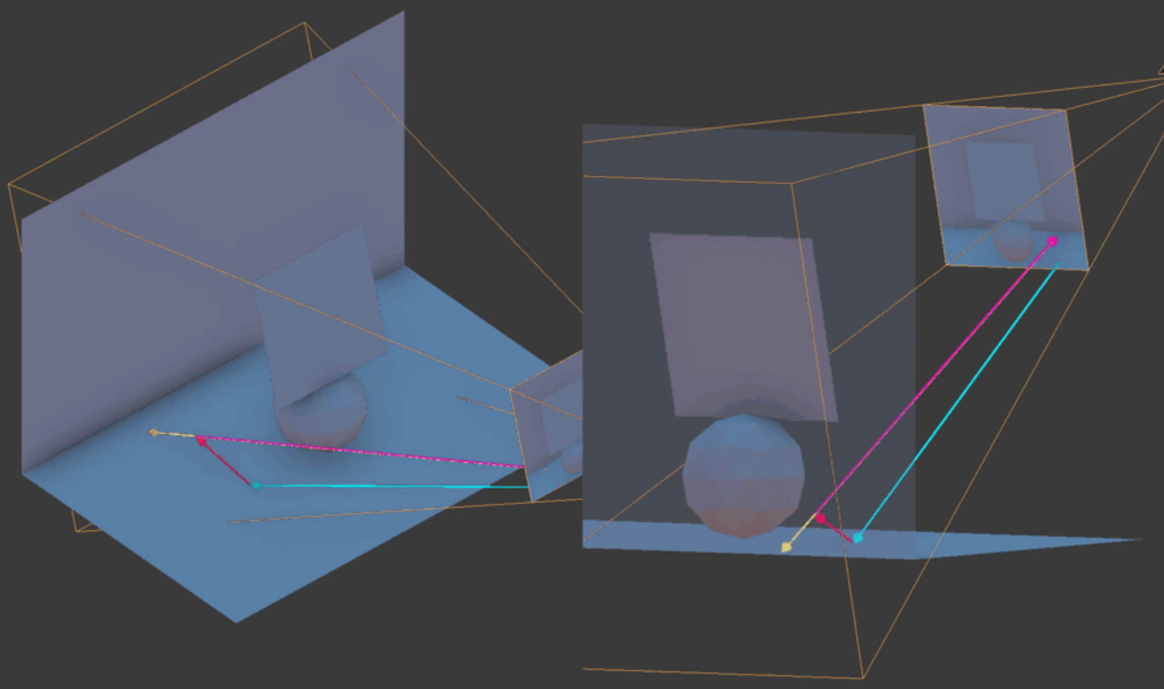
What do you need for Screen Space Reflection?
Ray Marching (not far from Ray Tracing)
Position Transformations

Slide 5
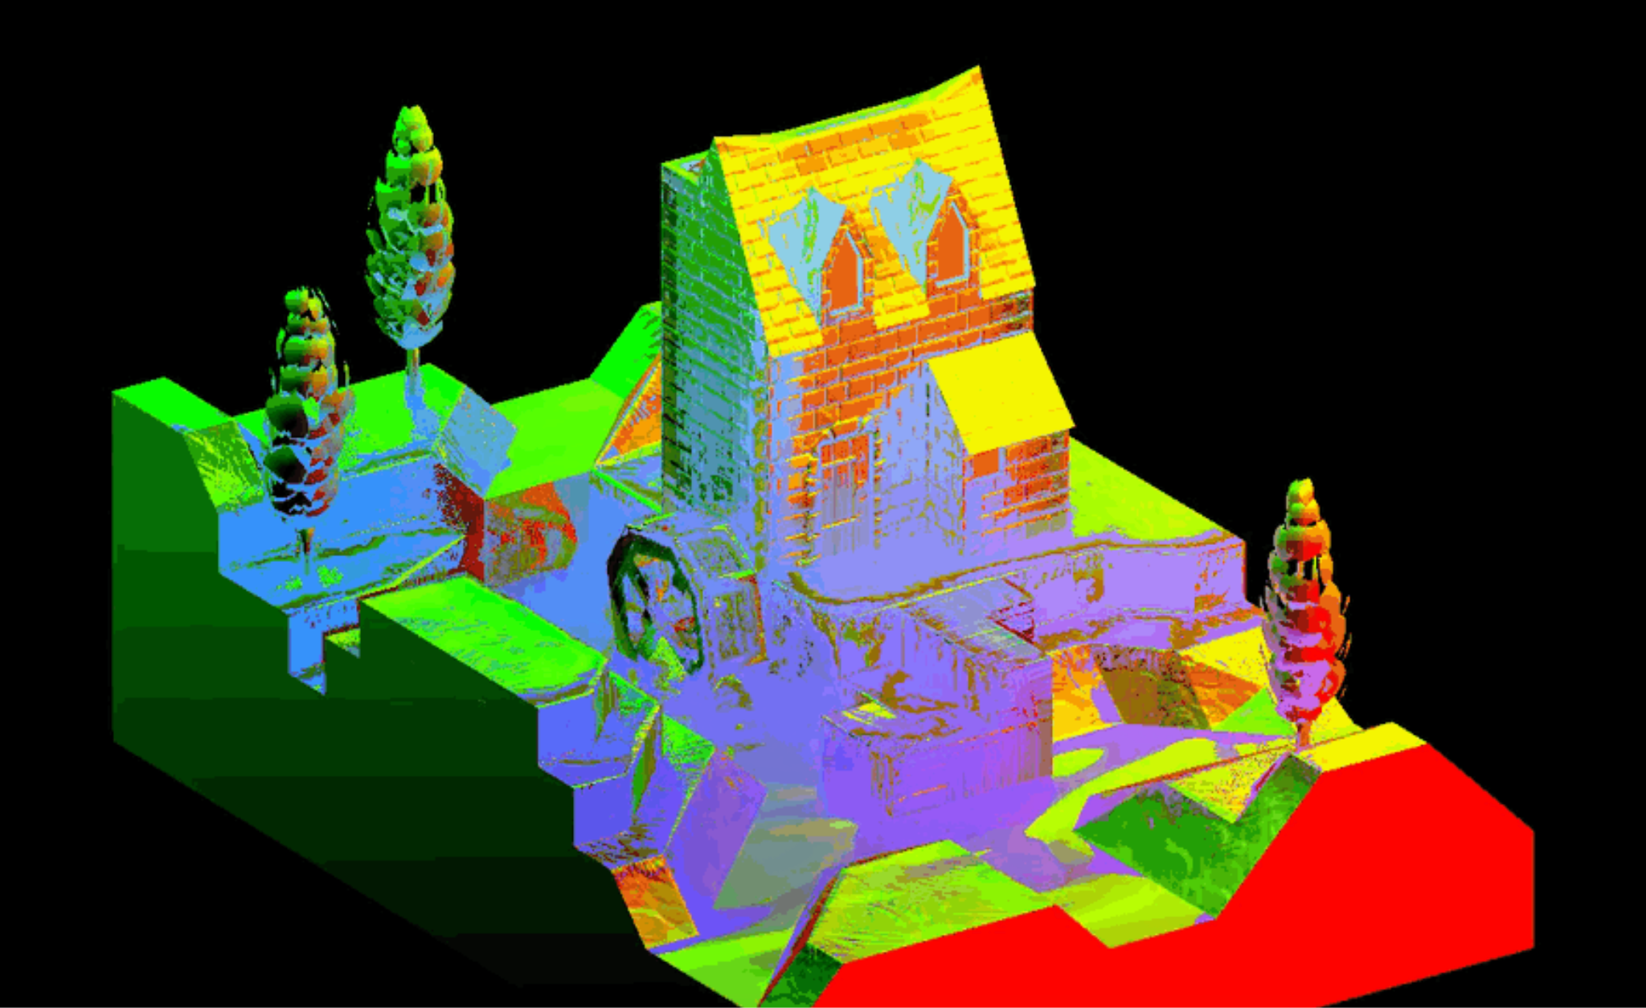
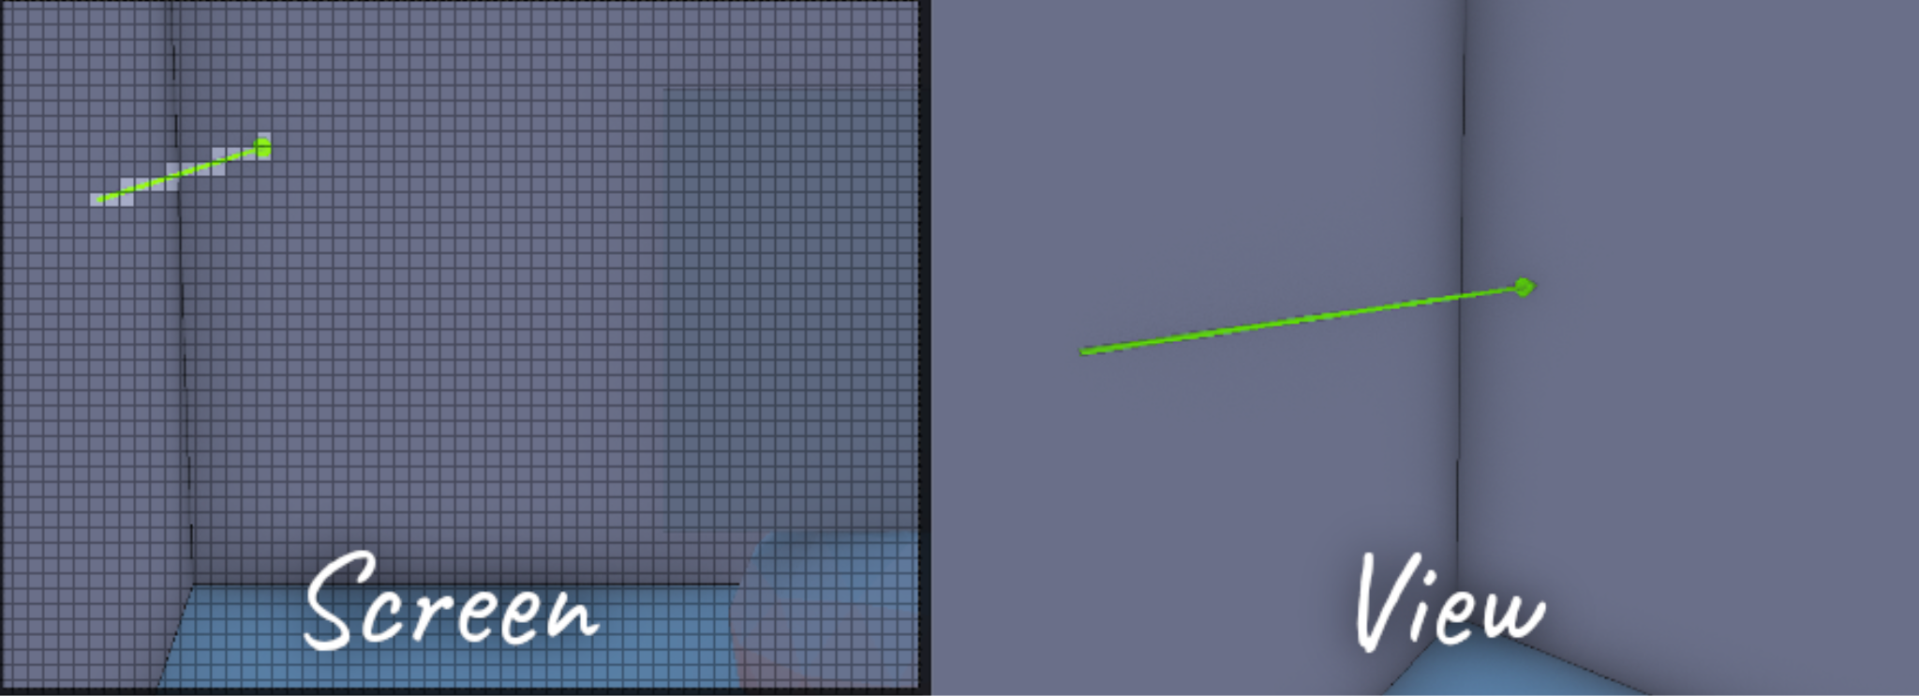
What do you need for Screen Space Reflection?
Reflected UV coordinates
Fragment positions for the framebuffer

Slide 6
Source
3D Game Shaders For Beginners Screen Space Reflection (SSR)
https://lettier.github.io/3d-game-shaders-for-beginners/screen-space-reflection.html

